Slide 1



Gentle Introduction to Machine Learning and Generative AI

Slide 2
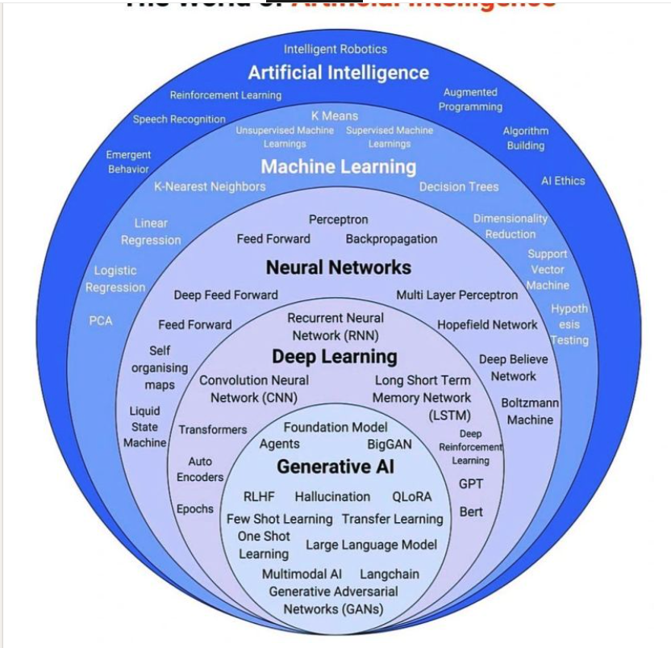
Venn Diagram of AI. ML and GenAI

Slide 4
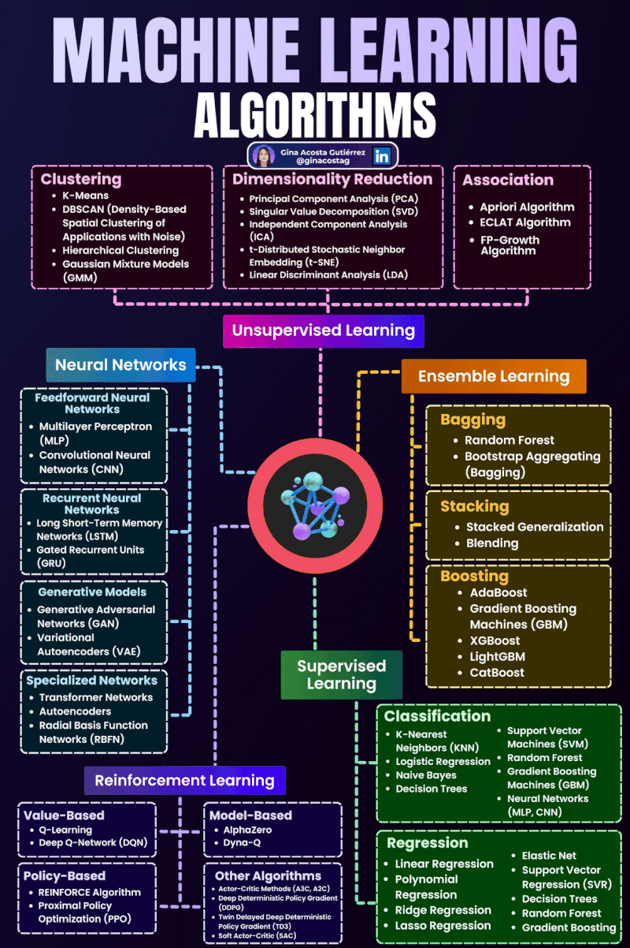

Slide 5
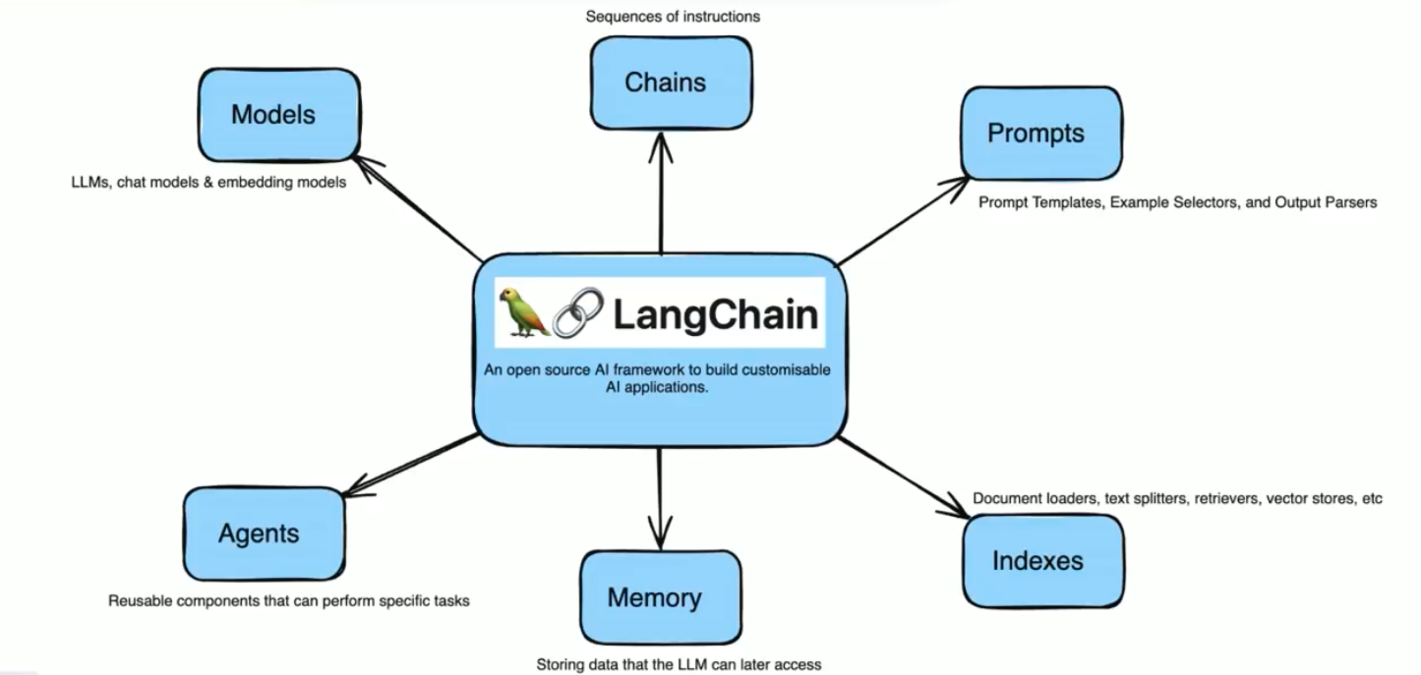
Langchain Interaction

Slide 6
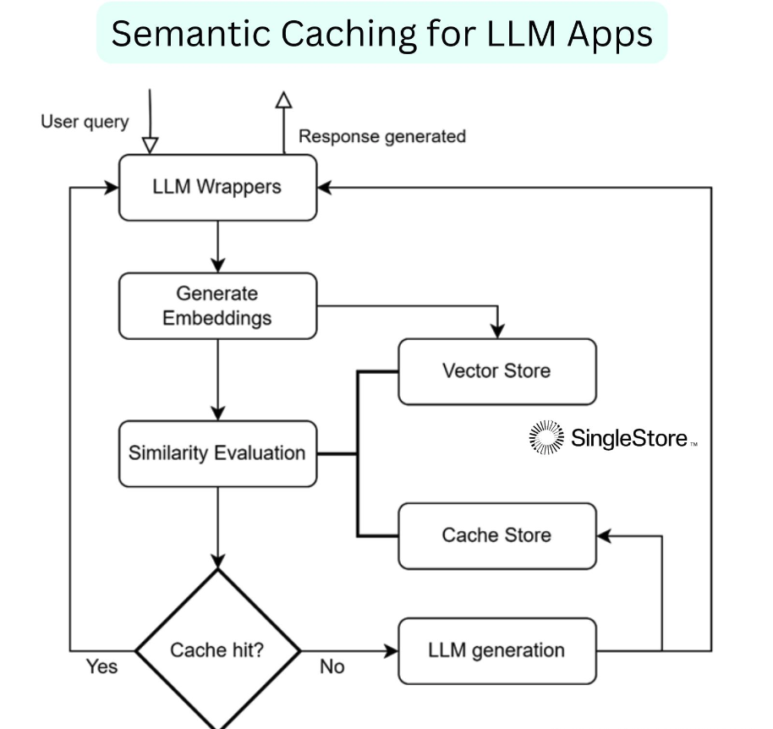

Slide 7


Slide 8
